Slide 1

Rationale
Introduction to Windows Store App Development Using HTML5 and JavaScript
Computer science is a field of study that deals with solving a variety of problems by using computers.
  To solve a given problem by using computers, you need to design an algorithm for it.
Multiple algorithms can be designed to solve a particular problem.
An algorithm that provides the maximum efficiency should be used for solving the problem.
  The efficiency of an algorithm can be improved by using an appropriate data structure.
Data structures help in creating programs that are simple, reusable, and easy to maintain.
This module will enable a learner to select and implement an appropriate data structure and algorithm to solve a given programming problem.

Slide 2
Objectives
  In this session, you will learn to:
  Add the UI elements to an app
Notes:
2

Slide 3
Image and Graphic Controls
  You can add images and graphics to your app by using the image and graphic controls.
Image and graphic controls
Image control
Canvas control
Notes:
3

Slide 4
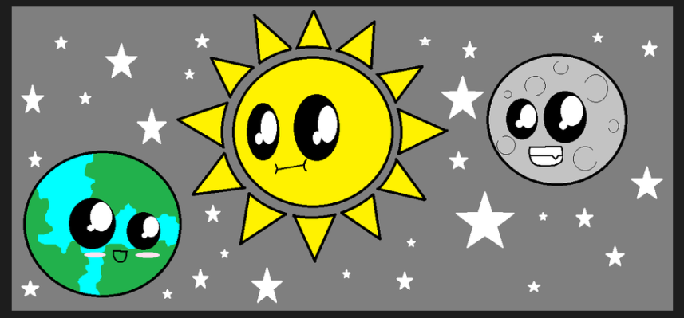
Image and Graphic Controls (Contd.)
  An image control:
  Can be used to display an image in your app.
  The following code snippet adds an image control to your app:
    <img src="images/earth1.png" />
  Output:
Notes:
4
The image is added in the images folder of the project.

Slide 5
Image and Graphic Controls (Contd.)
  A canvas control:
  Provides a surface on which images and graphics can be created or rendered.
  Creates a rectangular bitmap area in which you can dynamically render graphics.
  The following code snippet adds a canvas control to an app:
    <canvas id="canvas" width="100"
    height="100"></canvas>
Notes:
5
The image is added in the images folder of the project.

Slide 6

Image and Graphic Controls (Contd.)
  The following code snippet creates a rectangle on the created canvas:
        function draw() {
        var canvas = document.getElementById("canvas");
        var context = canvas.getContext("2d");
        context.fillStyle = "red";
        context.fillRect(15, 15, 55, 50);
        }
  To execute the code enclosed in the preceding function, you need to invoke this function on the occurrence of an event.
  Output:
Notes:
6
The image is added in the images folder of the project.

Slide 7
Demo: Designing the UI of an App
  Problem Statement:
  Nancy is passionate about watching and reviewing movies, and sharing the latest movie reviews with her friends. Therefore, she decides to create a Windows Store app that will allow her to write the movie reviews, rate the movies on a five point scale, and share the reviews with her friends. She wants to publish this app on Windows Store so that people with a similar passion for movies can use the app to rate their favorite movies. As the first step, she wants to design the UI for this app.
Notes:
7

Slide 8
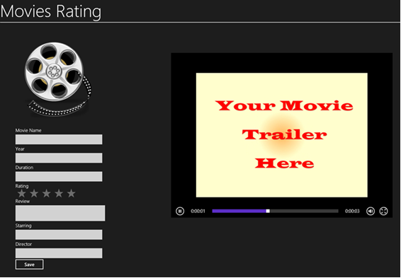
Demo: Designing the UI of an App (Contd.)
  The UI of this app should appear as shown in the following figure.
  Help Nancy develop the preceding UI.
Notes:
8

Slide 9
Demo: Designing the UI of an App (Contd.)
  Solution:
  To create the UI of the preceding app, Nancy needs to perform the following tasks:
      1. Create a blank Windows Store app.
      2. Add media files in the app.
      3. Add UI elements to the app interface.
      4. Execute the app and verify the output.
Notes:
9

Slide 10
Summary
  In this session, you learned that:
  You can add images and graphics to your app by using the image and graphic controls.
Notes:
10

Slide 11

Q&A

